Slide 1

ELECTORAL BONDS
DATA ANALYSIS
PORTFOLIO PROJECT
USING EXCEL, POSTGRESQL AND POWER BI
PRESENTED BY: ANKAN BANDYOPADHYAY

Slide 2

ABOUT THE PROJECT
On 15th February, the Supreme Court of India scrapped the Electoral Bond Scheme introduced in 2018, which allowed anonymous political funding, and ordered the disclosure of donors, the amount they donated, and the recipients. The Election Commission published the electoral bonds data shared by SBI on its website. The data released showed the details of the purchase of electoral bonds by companies and individuals of denominations between Rs 1,000 to Rs 1 crore since April 12, 2019.
In this Data Analysis Project, I have delved deep into the data and found some insights published in public by the State Bank of India right after that.
The data was presented in two PDF files containing the donor data which included data of both companies and individual donors who donated and the Political parties data that collected those donations.
After converting those files into Excel format I did all the data cleaning. Also, I divided the donors' data into two separate Excel files. One, with the companies' data and the other one with the individual donors' data. Also, I included the Head Quarter City, Head Quarter State/ Province, and Country columns in the company's Excel file. Lastly, I converted all files into CSV format for simplicity of usage.
Using PostgreSQL I have answered some of the questions to craft insights from the data. I have used Power BI to present the data in a beautiful dashboard for better understanding.
Tools Used: Excel, PostgreSQL, and Power BI
N.B.: This project is only for study and practice purposes. There is no intention to misuse the data as well as malign any individual, company, or political party.

Slide 3
POSTGRESQL

Slide 4

ERD

Slide 5
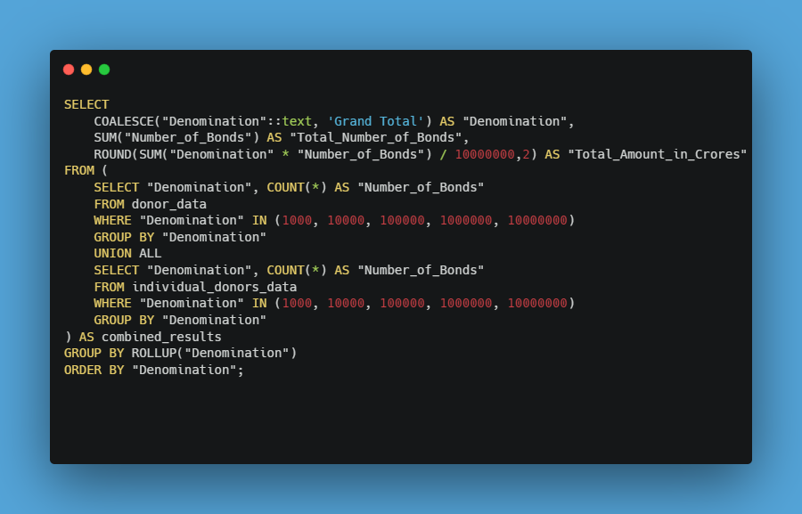
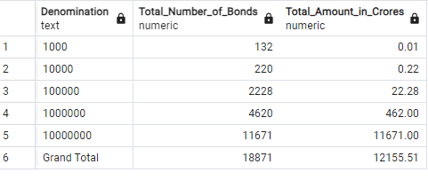
Q1. WHAT IS THE TOTAL NO OF BONDS PURCHASED OF EACH DENOMINATION AND THE ASSOCIATED VALUE (IN CRORES) OF THOSE BONDS?

Slide 6
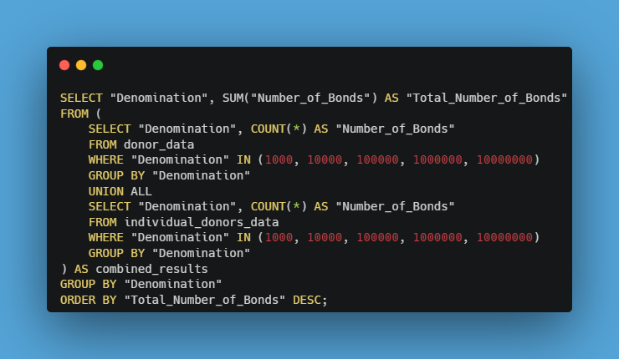
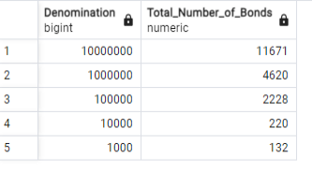
Q2. WHAT IS THE TOTAL NO OF BONDS OF EACH DENOMINATION I.E. 1000, 10000, 100000, 1000000, AND 10000000?

Slide 7
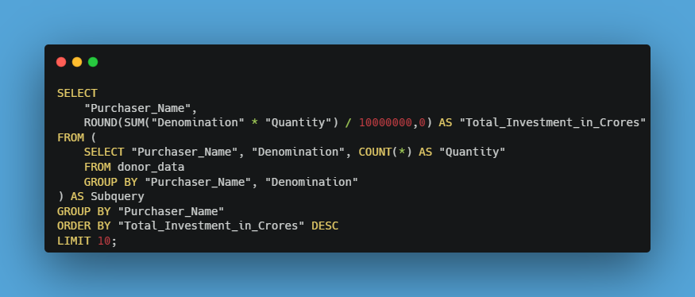
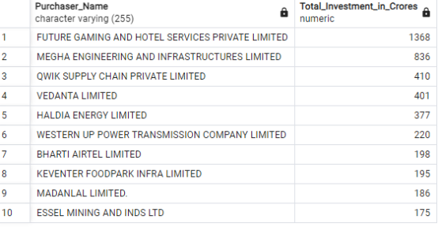
Q3. WHAT IS THE TOTAL INVESTMENT MADE (IN CRORES) BY THE TOP 10 COMPANIES IN ELECTORAL BONDS?

Slide 8
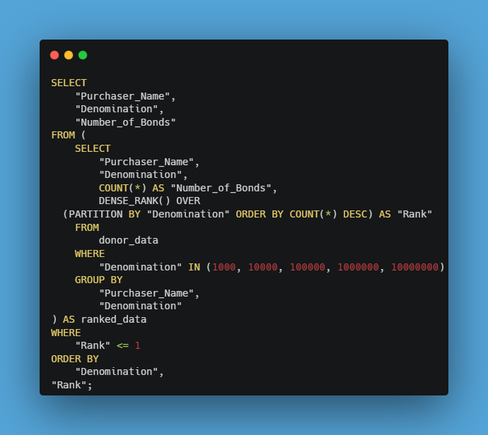
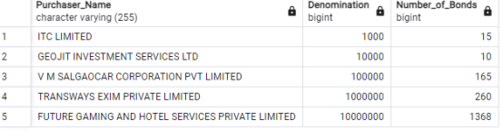
Q4. SHOW THE COMPANY WITH THE HIGHEST NUMBER OF BOND PURCHASES IN EACH DENOMINATION CATEGORY

Slide 9
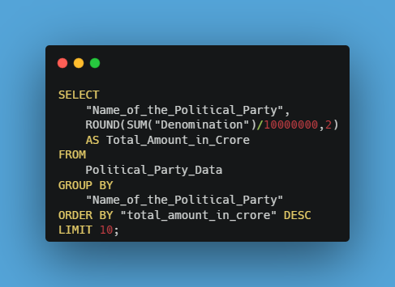
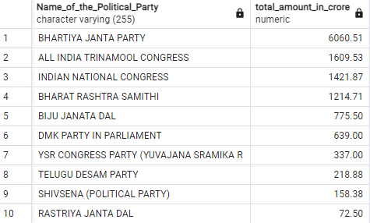
Q5. FETCH THE TOP 10 POLITICAL PARTIES' NAMES IN TERMS OF CASH RECEIVED AS DONATION.

Slide 10
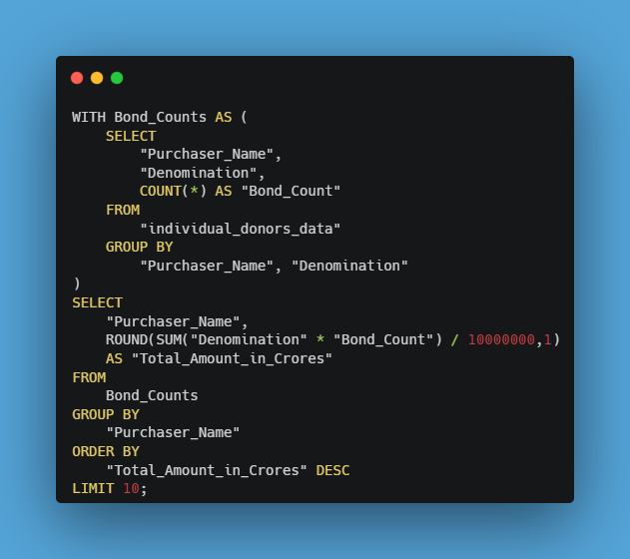
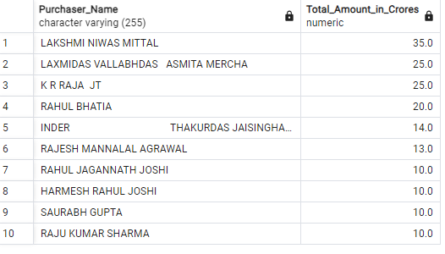
Q6. SHOW THE TOP 10 INDIVIDUAL INVESTORS IN ELECTORAL BONDS

Slide 11
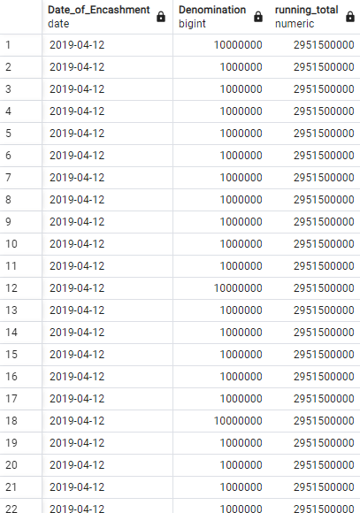
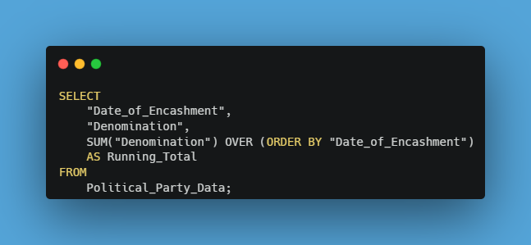
Q7. USE A WINDOW FUNCTION TO GET RUNNING TOTAL OF DONATIONS OVER TIME

Slide 12
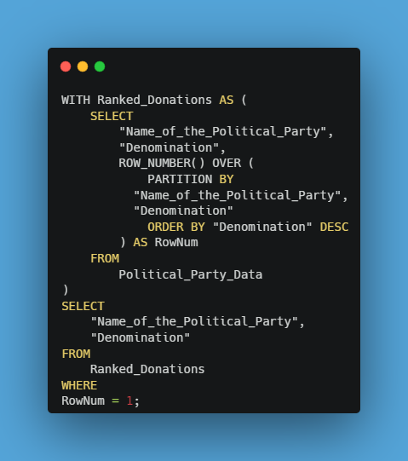
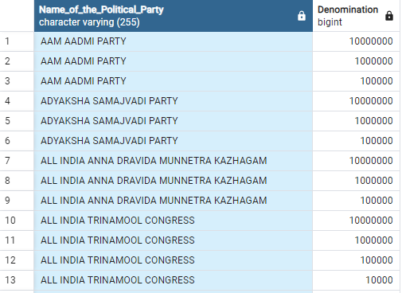
Q8. SHOW THE DENOMINATION CATEGORY OF THE DONATION RECEIVED BY EACH POLITICAL PARTY

Slide 13
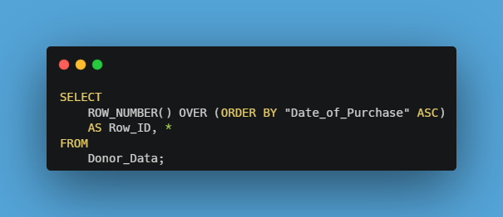
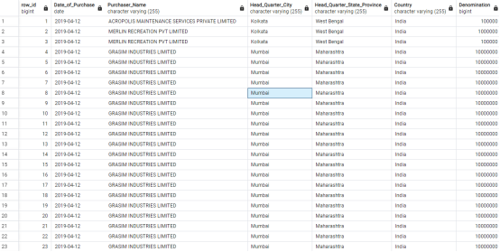
Q9. ASSIGN A UNIQUE ROW NUMBER TO EACH DONATION ENTRY

Slide 14
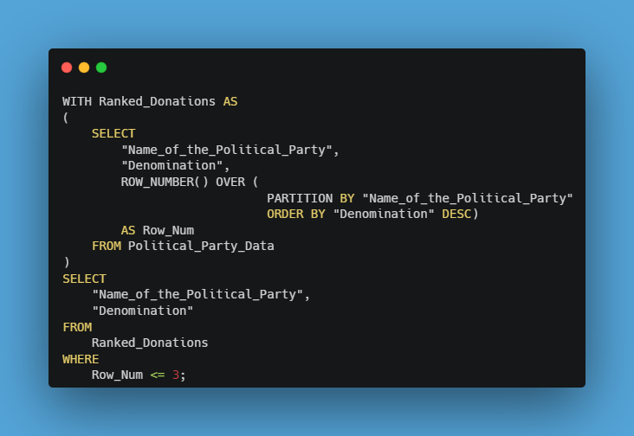
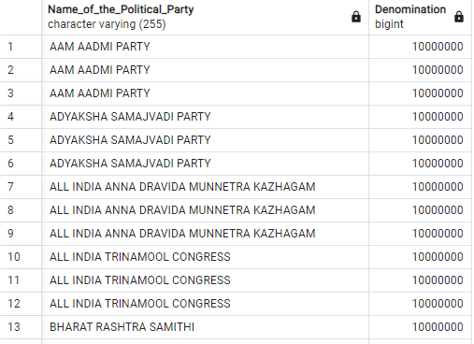
Q10. USE CTE WITH WINDOW FUNCTION TO FIND THE TOP 3 DONATIONS FOR EACH POLITICAL PARTY

Slide 15
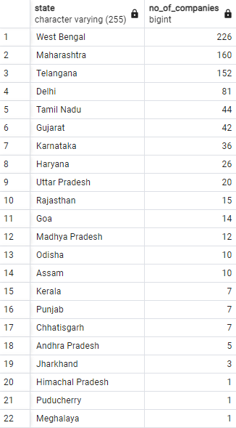
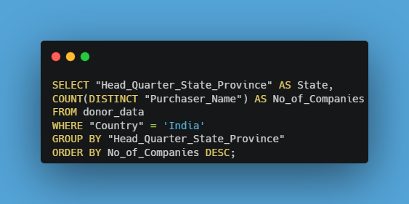
Q11. COUNT THE NUMBER OF COMPANIES FROM EACH STATE WITHIN INDIA.

Slide 16
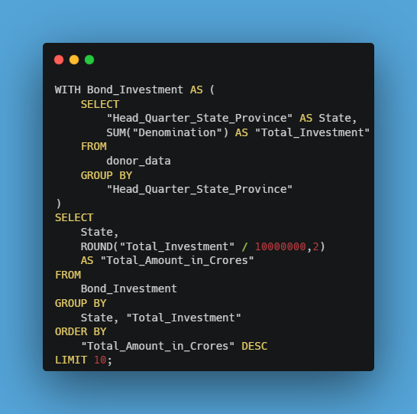
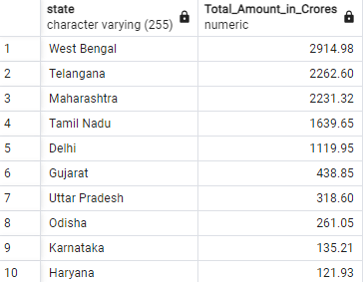
Q12. SHOW TOP 10 STATES WITH THE TOTAL AMOUNT OF INVESTMENT MADE

Slide 17
POWER BI

Slide 18
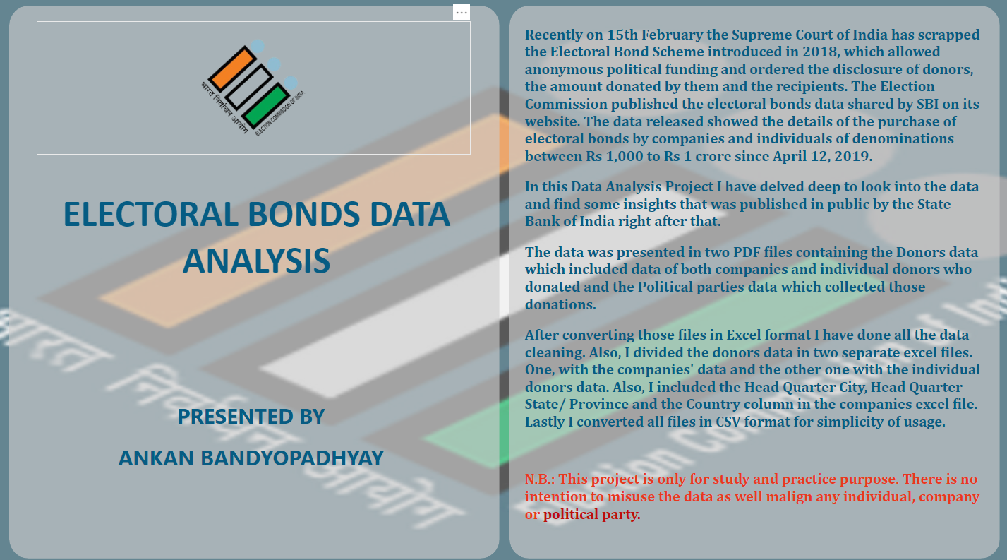

Slide 19
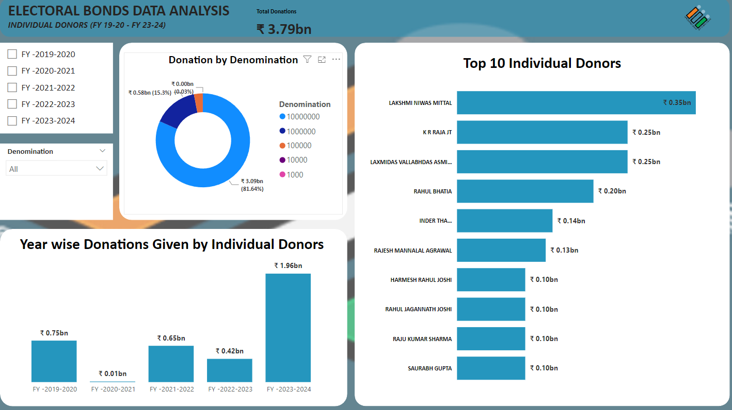

Slide 20
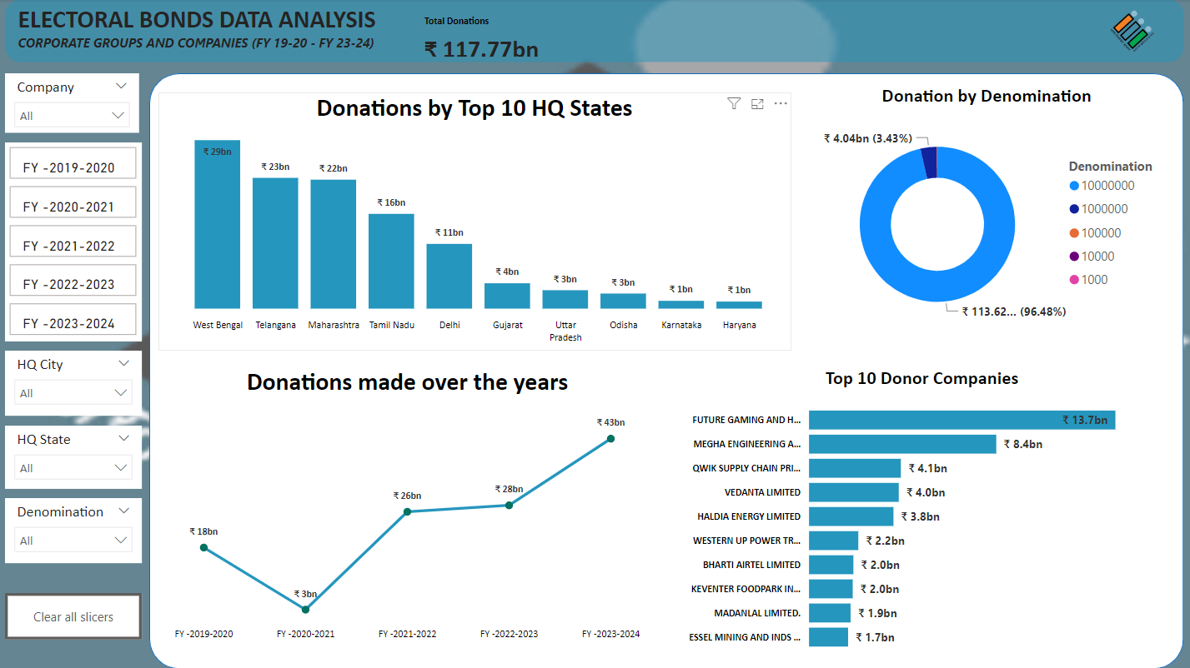

Slide 21
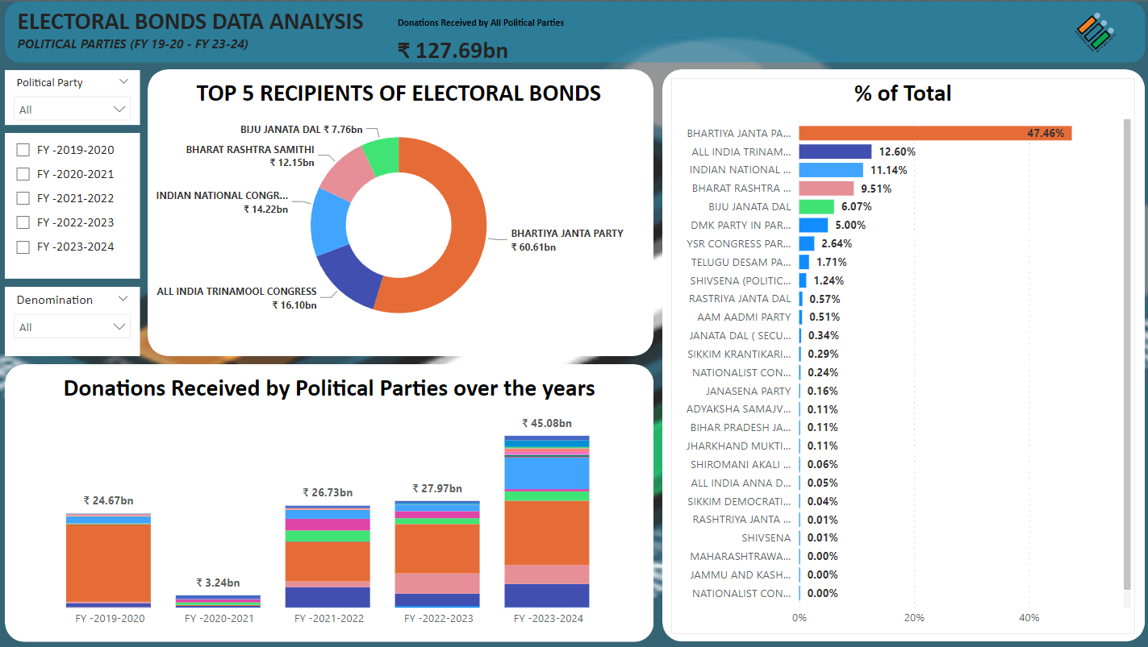

Slide 22
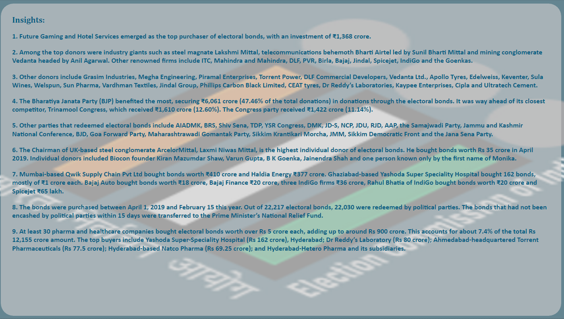

Slide 23


PRESENTED BY
Everest Cantu
Remy Marsh
Ankan
Bandyopadhyay
Ceo Of Ingoude Company
Ceo Of Ingoude Company

Slide 24
THANK'S FOR WATCHING

